Slide 1
Big Mountain
Xavier Enokian

Slide 2
Problem Identification and Recommendation
Big Mountain resort set their ticket prices based off the market average. However, Big Mountain resort is looking to implement a more data-driven strategy to set their ticket prices. Cutting operating costs was an option, but this was found to be irrelevant, as installing an additional chair lift would expect to bring in $3, 474, 638 in revenue while increasing the ticket price by just $1.99. Big Mountain is one of the top dogs in the ski resort business, boasting a higher number of facilities than most other ski resorts. It was found that Big Mountain was undercharging their ticket prices by ~$14 by comparing their own facilities to others in the marketplace, giving room for increase and a justification to install an additional chair lift. .

Slide 3
How was this conclusion made?
The conclusion that Big Mountain resort is undercharging was found by comparing its facilities to those of other resorts. Modeling will show just how much more Big Mountain resort has to offer than the other resorts. The following slides highlight Big Mountain’s facilities and compare it to other ski resorts across the country.

Slide 4
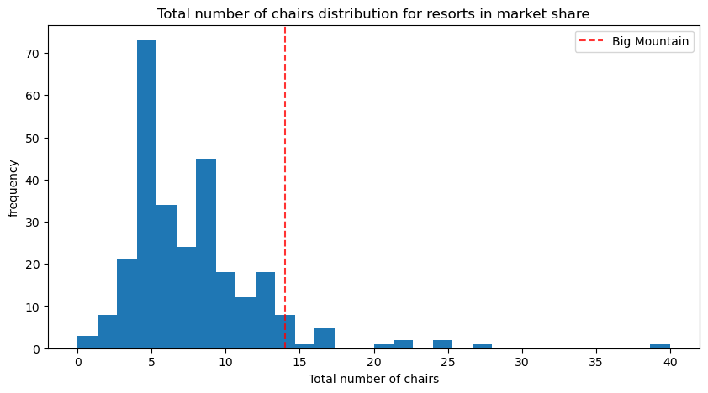

Slide 5
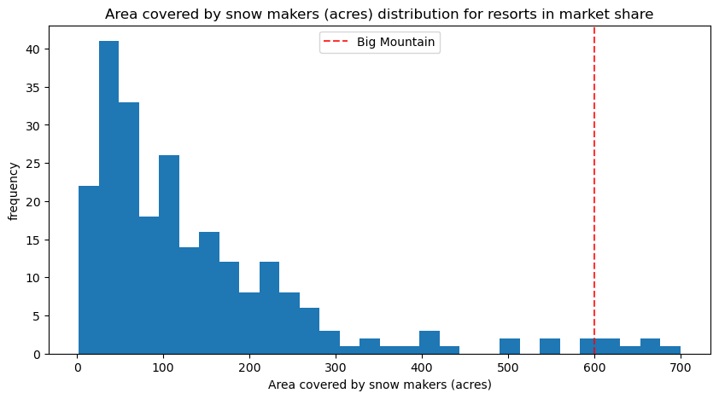

Slide 6
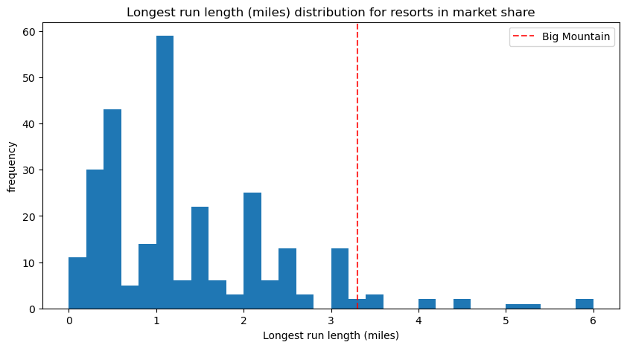

Slide 7
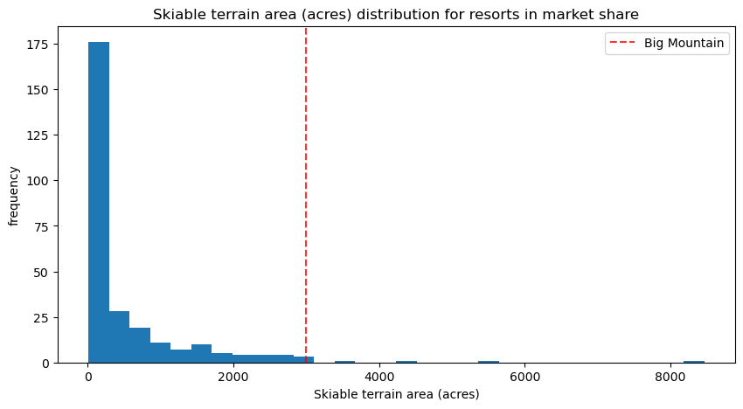

Slide 8
Summary
In summary, Big Mountain Resort has a lot to offer, and was previously being very generous with their ticket price. There was a $14 room for increase just by looking at its own facilities. Installing an additional chair lift would only raise the ticket price by $1.99, still leaving a $12 room for increase on their ticket price, while expected revenue for the additional chair lift is around $3.5 million.

